Slide 1
Exploring Venues in Indore

Slide 2
Introduction
The aim of the project is to identify venues in Indore, India based on their rating and average prices. In this notebook, we will identify various venues in the city of Indore, India, using Foursquare API and Zomato API, to help visitors select the restaurants that suit them the best.
Whenever a user is visiting a city they start looking for places to visit during their stay. They primarily look for places based on the venue ratings across all venues and the average prices such that the locations fits in their budget.
Here, we'll identify places that are fit for various individuals based on the information collected from the two APIs and Data Science. Once we have the plot with the venues, any company can launch an application using the same data and suggest users such information.

Slide 3
Data Collection From APIs
To begin with, we will take a look at Indore on the Map using the folium library.
We will also fetch the data from two different APIs.
Foursquare API: We will use the Foursquare API to fetch venues in Indore starting from the middle up to 6 Kilometres in each direction.
Zomato API: The Zomato API provides information about various venues including the complete address, user ratings, price for two people, price range and a lot more.

Slide 4
Foursquare API
We begin by fetching a total of all venues in Indore up to a range of 4 Kilometres using the Foursquare API. The Foursquare API has the explore API which allows us to find venue recommendations within a given radius from the given coordinates. We will use this API to find all the venues we need.
We'll call the API over and over till we get all venues from the API within the given distance. The maximum venues this API can fetch is 100, so we will fetch all venues by iteratively calling this API and increasing the offset each time.
Foursquare API requires client_id, and client_secret to function which can be accessed after creating a developer account.
We will set the radius as 4 Kilometers.
The version is a required parameter which defines the date on which we are browsing so that it retrieves the latest data.

Slide 5
Zomato API
The Zomato API allows using its search API to search for any given venue based on certain search filters such as query, latitude, longitude and more. Zomato also requires a Zomato user key which can be accessed with a developer account.
We'll use the name, lat, and lng values of various venues fetched from Foursquare API to use the search API and get more information regarding each venue.

Slide 6
The query will be the name of the venue.
The start defines from what offset we want to start, so we'll keep it at 0.
The count defines the number of restaurants we want to fetch. As we have the exact location coordinates, we'll fetch only one.
We will supply the latitude and longitude values.
We will set the sorting criteria as real distance so each time we get the venue we're searching based on location coordinates.

Slide 7
Data Cleaning
The data from multiple resources might not always align. Thus, it is important to combine the data retrieved from multiple resources properly.
We'll first plot the two data points on the map. We'll then try to combine data points that have their latitude and longitude values very close to one another. From the remaining selected venues, we will inspect the venues to ensure that any remaining mismatched venues are also removed from the final dataset of venues before we begin any analysis.
We will first plot the Foursquare data on the map.
From the map, we can infer that there are clusters of venues around Vijay Nagar, Palasia and Indore Junction. We can also plot the category count and see the major type of venues that exist.

Slide 8
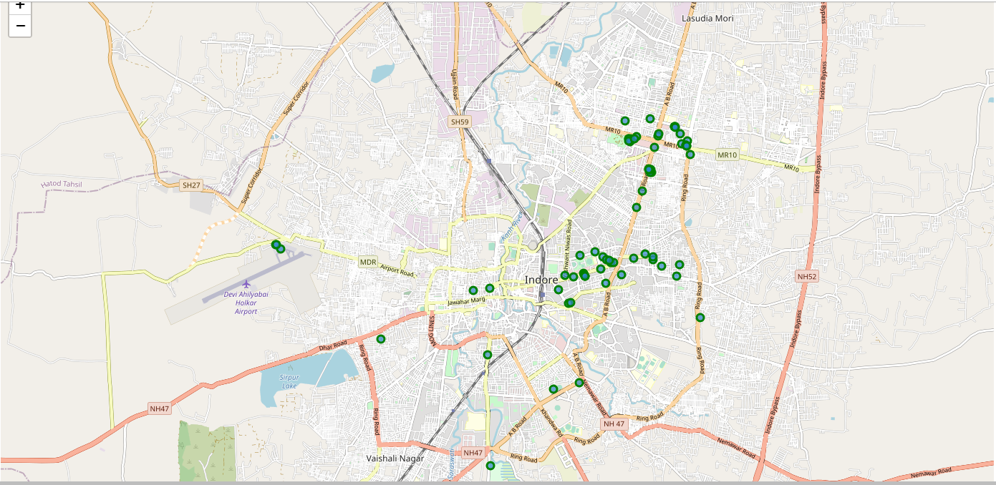

Slide 9
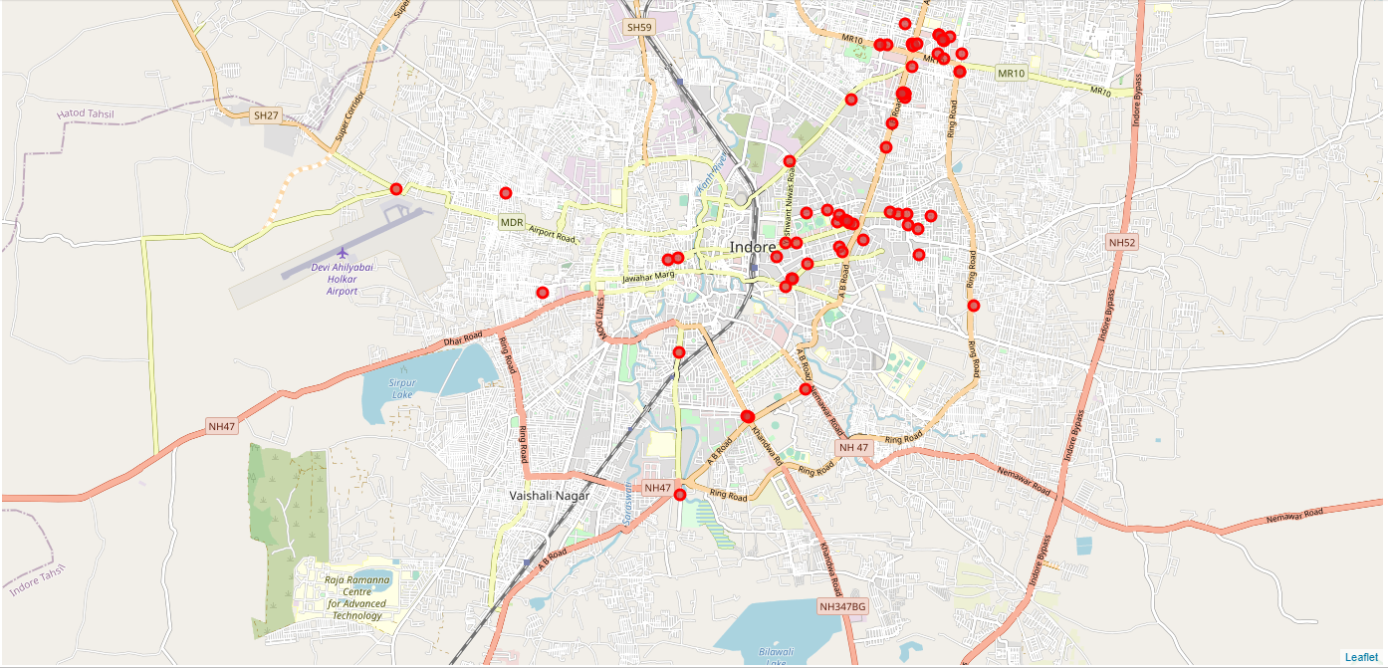

Slide 10
Taking a look at the names of venues from both APIs, some names are a complete mismatch.
Category 1: There are venues that have specific restaurants/cafes inside them as provided by Zomato API .
Category 2: Two locations are so close by that they have practically same latitude and longitude values .
Category 3: Some have been replaced with new restaurants.

Slide 11
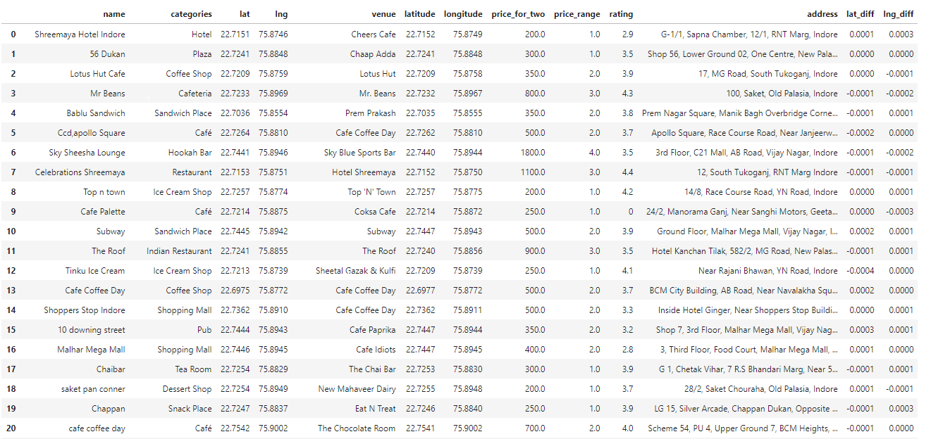

Slide 12
Methodology
This project aims at identifying the venues in __Indore__ based on their rating and average costs. This would enable any visitor to identify the venues he/she wants to visit based on their rating and cost preference.
As a first step, we retrieved the __data from two APIs (Foursquare and Zomato)__. We extract venue information from the centre of Indore, up to a distance of 6 Km. The latitude and longitude values are then used to fetch venue rating and price from Zomato.
Secondly, we then __explored the data__ retrieved from the two APIs on the map and identified the top category types. The __data from the two sources is carefully combined__ based on the name, latitude and longitude values from the two sources. The final dataset would include the rating and price values for each venue.
Next, we'll __analyse the data__ that we created based on the ratings and price of each venue. We'll __identify places where many venues are located__ so that any visitor can go to one place and enjoy the option to choose amongst many venue options. We'll also explore __areas that are high rated and those that are low rated__ while also plotting the map of high and low priced venues. Lastly, we'll cluster the venues based on the available information of each venue. This will allow us to clearly identify which venues can be recommended and with what characteristics.
Finally, we'll discuss and conclude which venues to be explored based on visitor requirement of rating and cost.

Slide 13
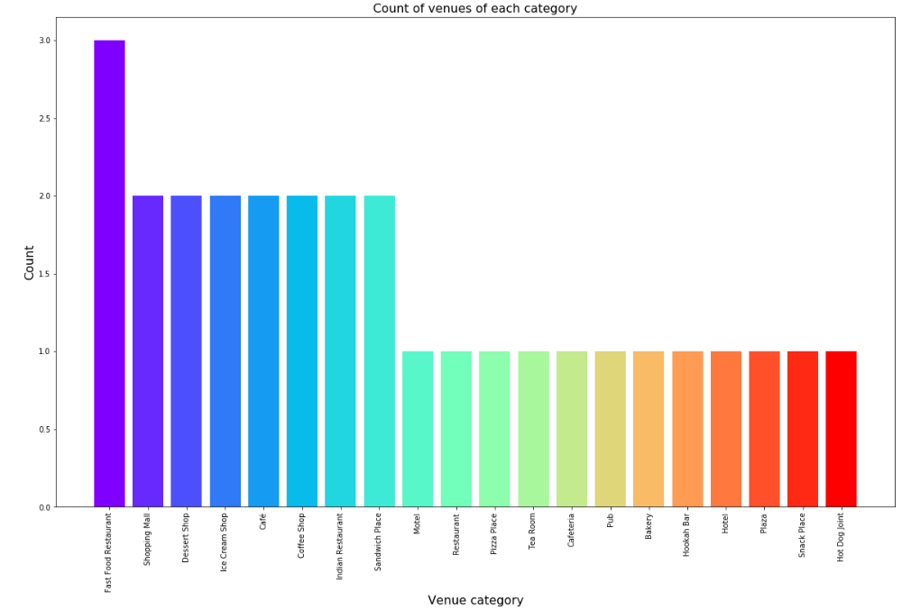
Categories
We have various types of venues in the final dataset. We will take a look at the venues and check which are the majority venue categories in the list.
As we can see the majority venues are Hotel and Indian Restaurant. So, if as a tourist, you're looking for cafes and Indian restaurants, you're in luck.

Slide 14
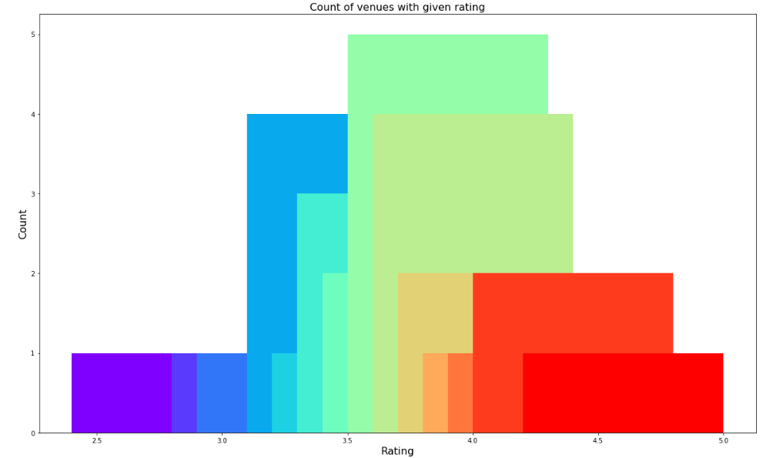
Rating
From the plot above, it is clear that majority venues have their rating close to 4.

Slide 15
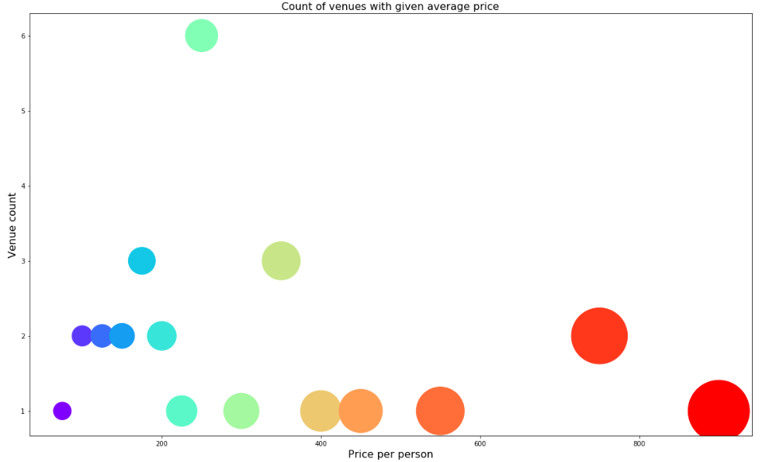
Price
From the plot above we can see that a large number of venues have an average price between Rs 400 and Rs 700.

Slide 16
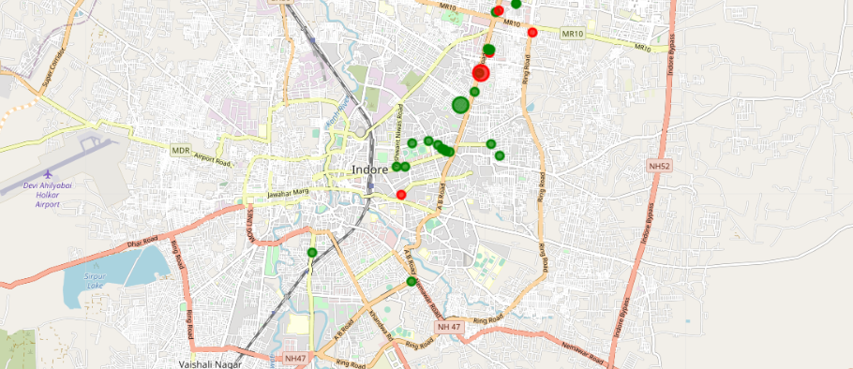
Clustering
From the map, we see the two clusters:
The first cluster is spread across the whole city and includes the majority venues.
The second cluster is very sparsely spread and has very limited venues.

Slide 17
Results and Discussion
Based on our analysis above, we can draw a number of conclusions that will be useful to aid any visitor visiting the city of Indore, India.
After collecting data from the Foursquare and Zomato APIs, we got a list of 90 different venues. However, not all venues from the two APIs were identical. Hence, we had to inspect their latitude and longitude values as well as names to combine them and remove all the outliers. This resulted in a total venue count of 35.
We identified that from the total set of venues, majority of them were Cafes and Indian Restaurants. A visitor who loves Cafes/Indian Restaurants would surely benefit from coming to Indore.
While the complete range of ratings range from 1 to 5, the majority venues have ratings close to 4. This means that most restaurants provide good quality food which is liked by the people of the city, thus indicating the high rating. When we plot these venues on the map, we discover that there are clusters of venues around Vijay Nagar, Palasia and Rajbada. These clusters also have very high ratings (more than 3).

Slide 18
When we take a look at the price values of each venue, we explore that many venues have prices which are in the range of Rs 400 to Rs 700 for one person. However, the variation in prices is very large, given the complete range starts from Rs 100 and goes uptil Rs 1200. On plotting the venues based on their price range on the map, we discovered that venues located near Vijay Nagar and Rajbada are relatively priced lower than venues in Palasia.
Finally, through clusters we identified that there are many venues which are relatively lower priced but have an average rating of 3.57. On the other hand, there are few venues which are high priced and have average rating of 4.03.
If you're looking for cheap places with relatively high rating, you should check Vijay Nagar.
If you're looking for the best places, with the highest rating but might also carry a high price tag, you should visit Palasia and Rajbada.
A company can use this information to build up an online website/mobile application, to provide users with up to date information about various venues in the city based on the search criteria (name, rating and price).

Slide 19
Conclusion
The purpose of this project was to explore the places that a person visiting Indore could visit. The venues have been identified using Foursquare and Zomato API and have been plotted on the map. The map reveals that there are three major areas a person can visit: Vijay Nagar, Rajbada & Palasia. Based on the visitor's venue rating and price requirements, he/she can choose amongst the three places.

